Slide 1
Creating Javadocs

Slide 2
What Are Javadocs?
Javadoc is a tool that generates html documentation (similar to the reference pages at java.sun.com) from Javadoc comments in the code.

Slide 3
Javadoc Comments
Javadoc allows you to attach descriptions to:
Classes
Constructors
Methods
Fields
Interfaces
Javadoc processes comments:/** ……..*/
The first sentence should be descriptive.
Use /** * This is Dr.&nbsp;Phil's class. */

Slide 4
Javadoc Simple Example
/** Class Description of MyClass */
public class MyClass {
/** Field Description of myIntField */
public int myIntField;
/** Constructor Description of MyClass() */
public MyClass() {
// Do something ...
}
}

Slide 5
Javadoc Tags
Tags are keywords recognized by Javadoc which define the type of information that follows.
Tags come after the description.
Here are some common pre-defined tags:
@author [author name] - identifies author(s) of a class or interface.
@version [version] - version info of a class or interface.
@param [argument name] [argument description] - describes an argument of method or constructor.
@return [description of return] - describes data returned by method (unnecessary for constructors and void methods).
@exception [exception thrown] [exception description] - describes exception thrown by method.
@throws [exception thrown] [exception description] - same as @exception.

Slide 6
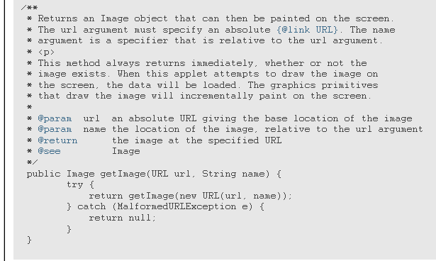
Javadoc Example
Source: http://java.sun.com/j2se/javadoc/writingdoccomments/

Slide 7
Style Tips
Use <code> for keywords and names. Keywords and names are offset by <code>...</code> when mentioned in a description. This includes:
Java keywords
package names
class names
method names
interface names
field names
argument names
code examples

Slide 8
Style Tips Cont’
Use in-line links economically
Omit parentheses for the general form of methods and constructors.
The add method enables you to insert items. (preferred)
The add() method enables you to insert items. (avoid)
Use phrases instead of complete sentences,in the interests of brevity.

Slide 9
Language
Use 3rd person (descriptive) not 2nd person (prescriptive).The description is in 3rd person declarative rather than 2nd person imperative.
Gets the label. (preferred)
Get the label. (avoid)
Method descriptions begin with a verb phrase. A method implements an operation, so it usually starts with a verb phrase:
Gets the label of this button. (preferred)
This method gets the label of this button. (avoid)
Source: http://java.sun.com/j2se/javadoc/writingdoccomments/

Slide 10
Tag Order
Order of Tags Include tags in the following order:
@author (classes and interfaces only, required)
@version (classes and interfaces only, required.)
@param (methods and constructors only)
@return (methods only)
@exception (@throws added in Javadoc 1.2)
@see
@since
@serial (or @serialField or @serialData)
@deprecated

Slide 11
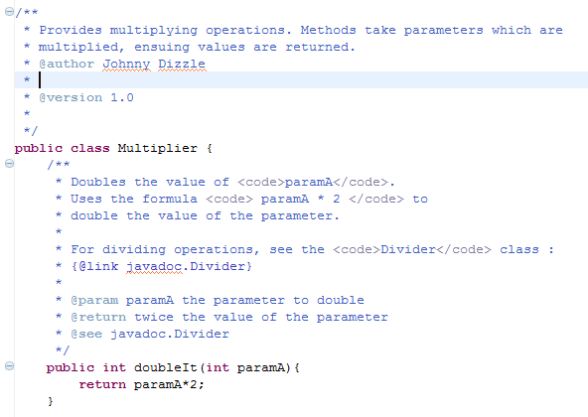
Try this! (Or something similar)
Make two classes with javadoc using:
Class documentation
{@link …}
<code></code>
@param
@return
@version
@see
@deprecated

Slide 12
Javadoc Compilation
In Eclipse, go to the Project Menu. Select Generate Javadoc…
Browse for the Javadoc command. This should be something like:
C:\Program Files\Java\jdk1.6.0_10\bin\javadoc.exe

Slide 13
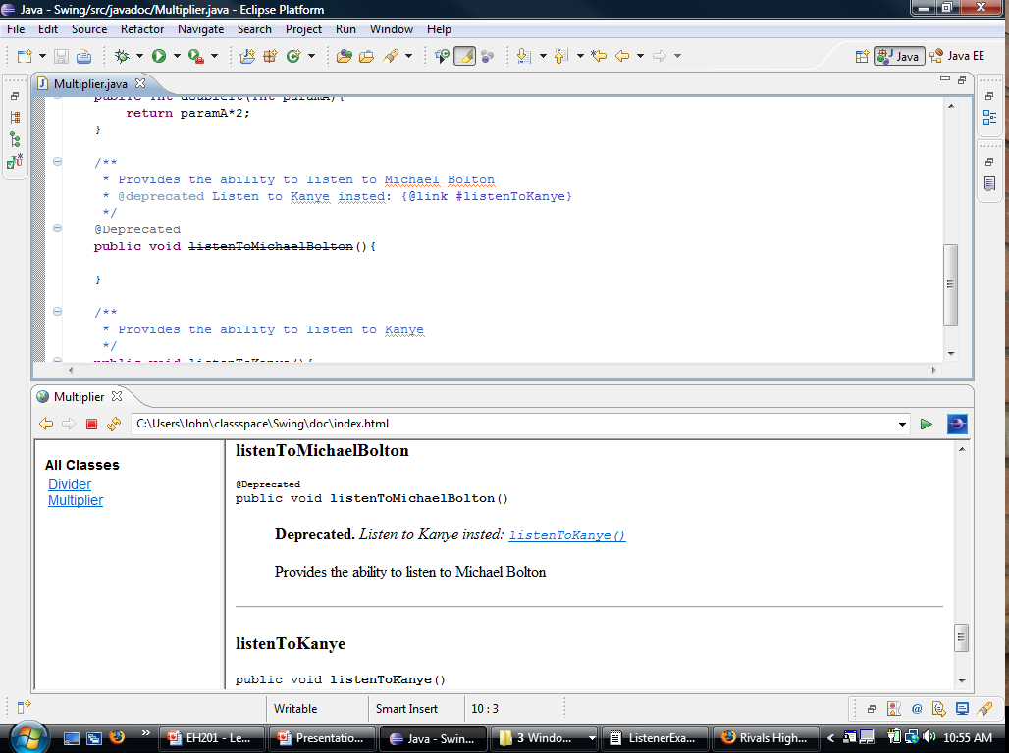

Slide 14
Resources
http://www.eclipse-blog.org/eclipse-ide/generating-javadoc-in-eclipse-ide.html
http://java.sun.com/j2se/javadoc/writingdoccomments/
http://www.mcs.csueastbay.edu/~billard/se/cs3340/ex7/javadoctutorial.html

